Slide 1



Introductions
Jacob Friedberg
IT Manager
GitHub
Technical help

Slide 2

Dream Team Studio’s

Slide 3

Adventure

Slide 4
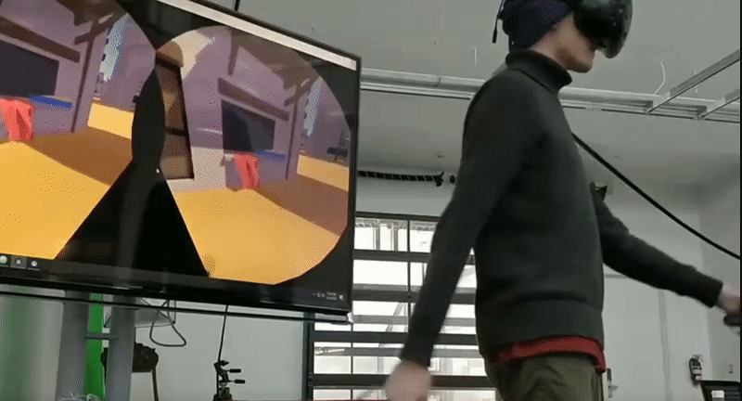
Advanced virtual reality Locomotion.

Slide 5

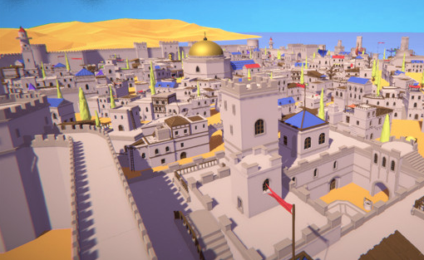



New revamped worldspace

Slide 6
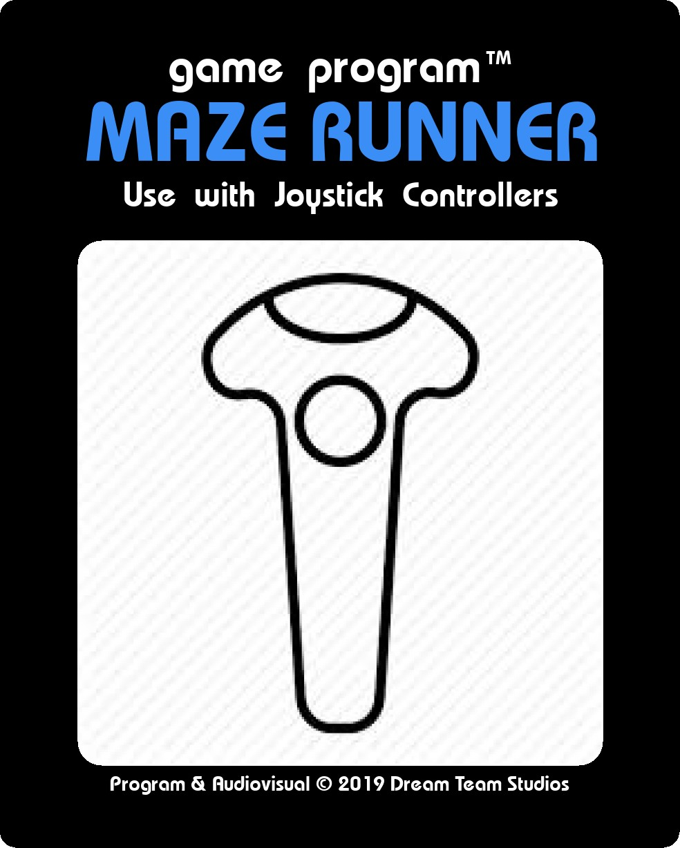
Release: Q1 2019

